Slide 1
Building one of the Best State Universities in Turkey!

Slide 2
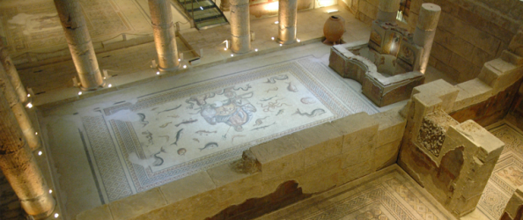
Gaziantep is one of the oldest culture centers of Turkey.
6th largest city in Turkey with a population of 2.1 million.
Culturally and socio-economically the most developed city in its region.
Gaziantep
at a Glance
Gaziantep is one of the oldest culture centers of Turkey.
6th largest city in Turkey with a population of 2.1 million.
Culturally and socio-economically the most developed city in its region.
World’s second biggest mosaic museum.

Slide 3
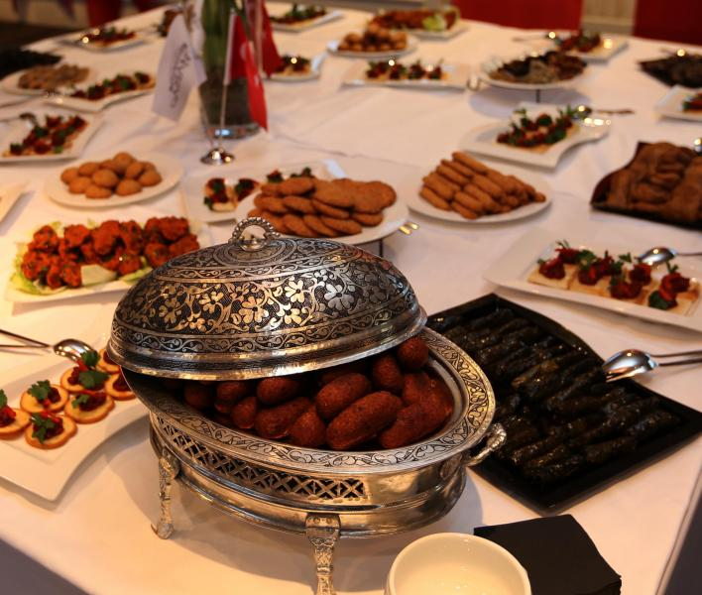
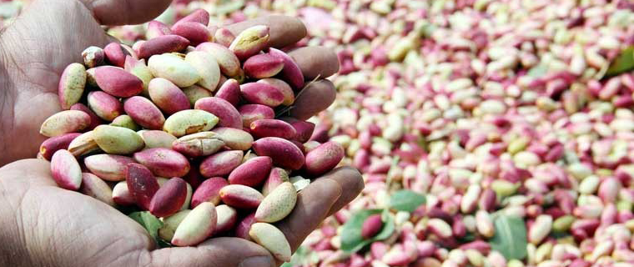
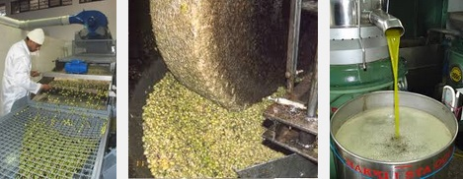
Agricultural Production
In Gaziantep, the agriculture is done in 370.736 hectares yards. Particularly Antep pistachios, olive and grape varieties are grown in the fields.
There are nearly 50 millions of pistachio
trees in the region.
It has the best Turkish food in the country.
Awarded as “City of Gastronomy” by UNESCO

Slide 4
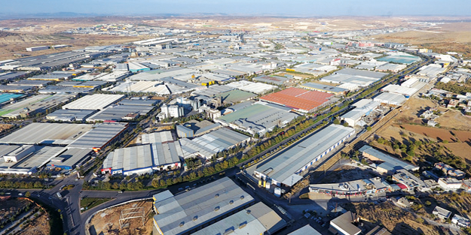
The number of large industry businesses established in Gaziantep comprise four percent of the Turkish industry in general, and small industries comprise six percent.
Largest trade and industrial center in the region.
Gaziantep has three organized industrial zones covering 12 million sqm.
The industrial sector with many small and medium size businesses offers a wide opportunity of employment. Around 20.000 employees in each zone.

Slide 5
Gaziantep University; providing quality education to more than 45.000 students, 3.800 of whom are international students from 107 countries, is taking firm steps towards becoming a world university with its strong academic staff, physical infrastructure, social and cultural opportunities.
Gaziantep University has the characteristics of a university which is delicately followed due to its exemplary projects for other universities like Intern Education Model and Civic Involvement Projects.
It is aimed to transfer knowledge, science, wisdom and cultural accumulation from GAUN to the entire Middle East and aimed to protect humanity and basic values and add value to the socio-economic development of the region by bringing together the qualifications acquired in a common platform.
Our university will proceed to be a home where not only successful doctors, engineers, and teachers are educated and trained but also an educational institution that does not avoid any sacrifice in the way of educating students who will open to the world with their international identity. As universities, beyond providing the academic success of their students, are life areas that aim to make them lifelong productive and happy. With this understanding and 46 years of experience, Gaziantep University will continue to be the guarantee of our future in our bright journey.
University
at a Glance

Slide 6
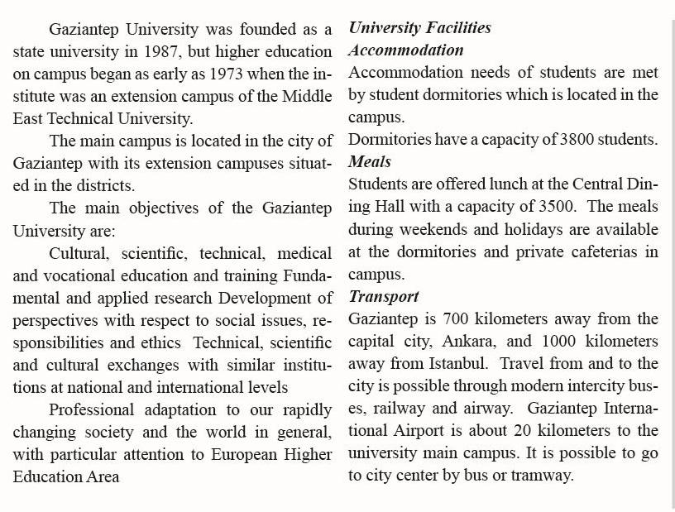
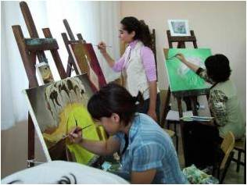
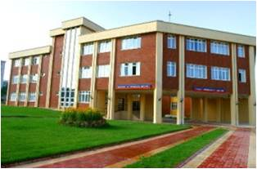

Slide 7
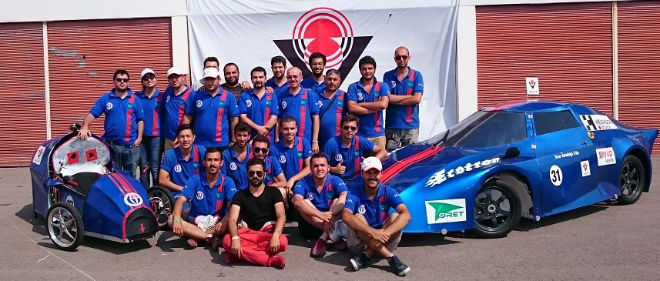
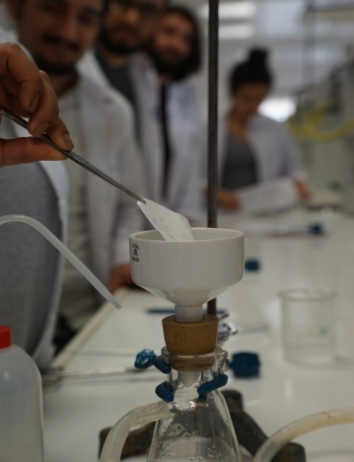
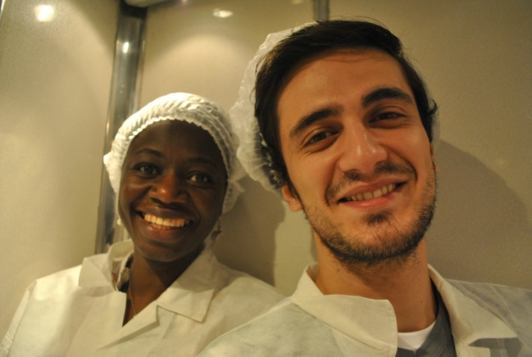
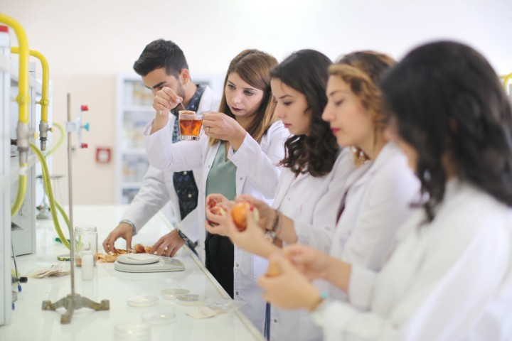
7.465 Graduate Students
24.929 Undergraduate Students
8.803 Associate Degree Students
3.829 International Students
45.026 TOTAL STUDENT NUMBER (2019)
172 Professors
114 Associate Professors
334 PhD.
365 Lecturer
540 Researcher
1525 TOTAL ACADEMIC STAFF NUMBER
Facts and Figures
You can study in
ARABIC, ENGLISH or in
TURKISH
@GAUN
20 Faculties
5 Graduate Schools
2 Vocational Schools
11 Higher Vocational Schools
28 Research Centers

Slide 8
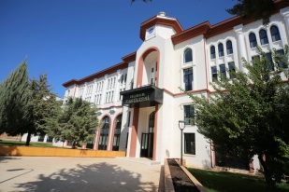
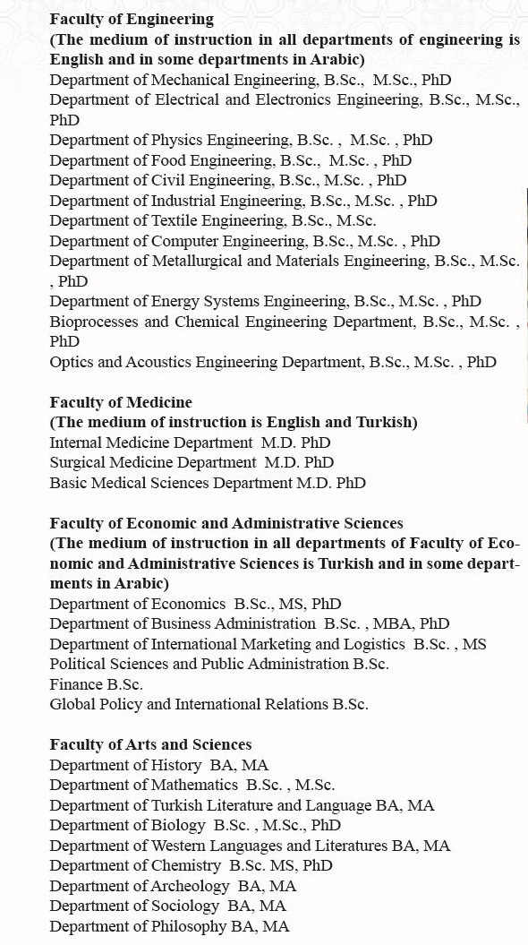
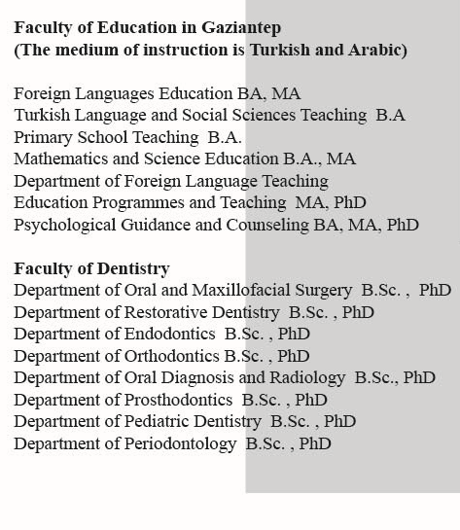
Teaching excellence with Top Notch Professors is core to GAUN's mission
Faculties and Departments

Slide 9
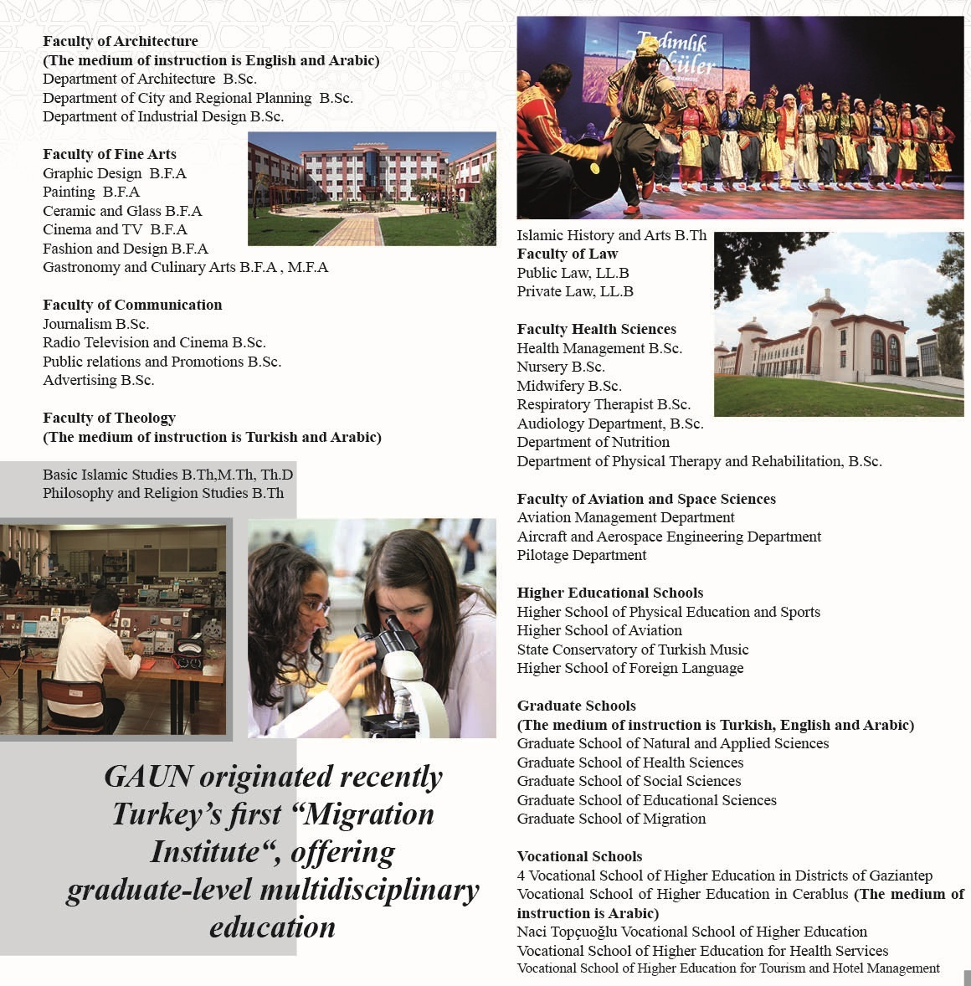
Faculties and Departments

Slide 10
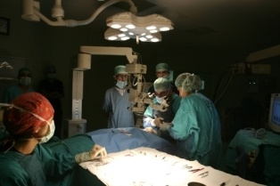
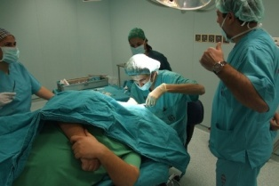
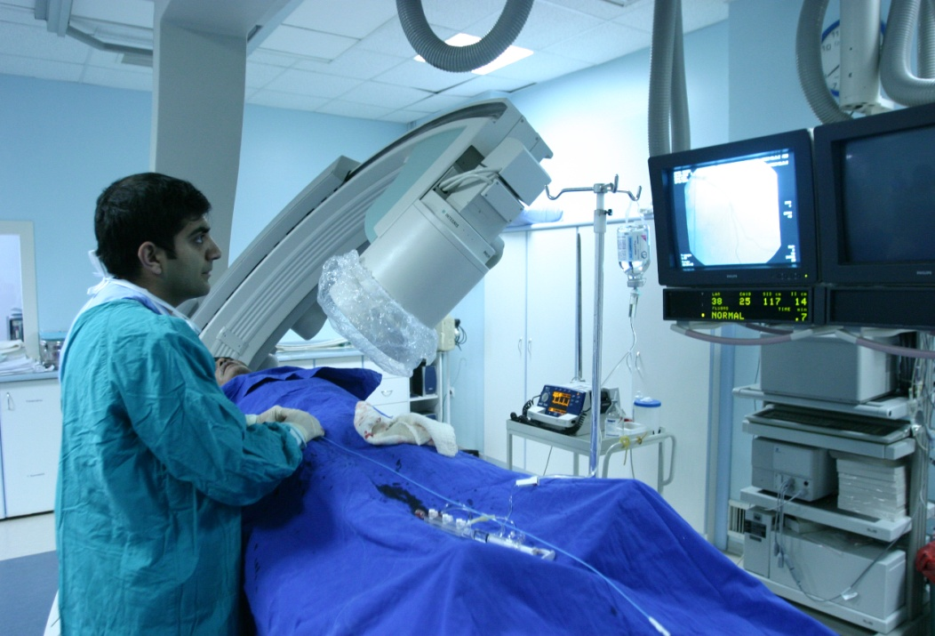
Research and Application Hospital

Slide 11
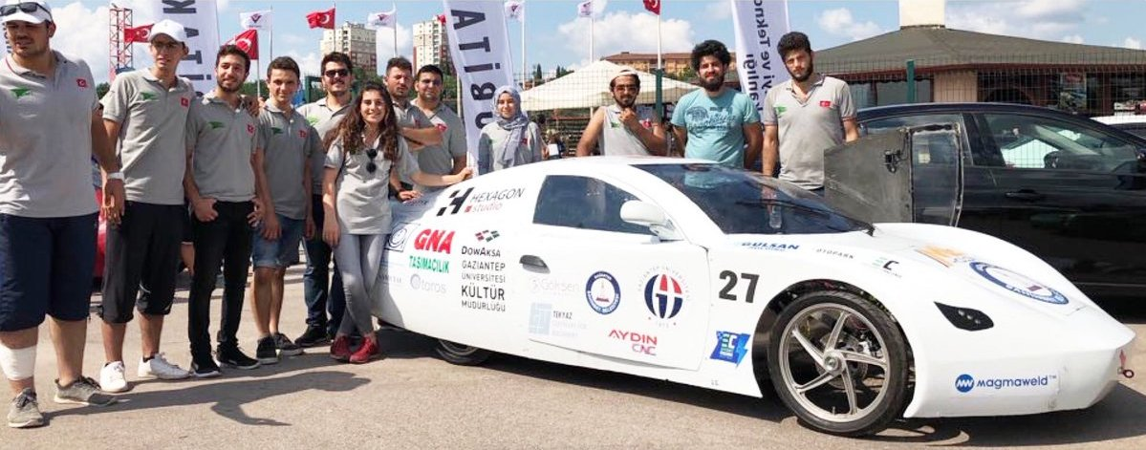
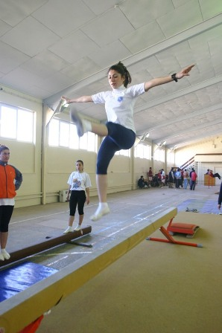
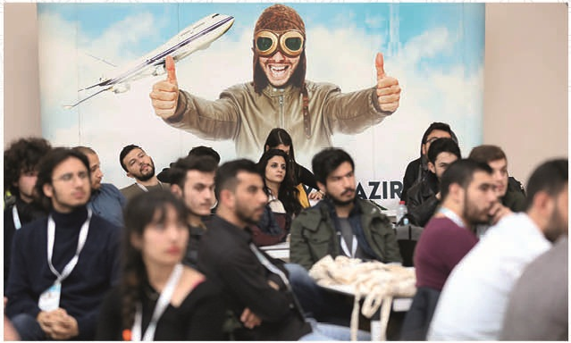
Electronics and Robotics Club awarded
“The visual design award”
for the Efficiency Challenge Electric Vehicle
By The Scientific and Technological Research Council of TURKEY
Leisure Activities

Slide 12
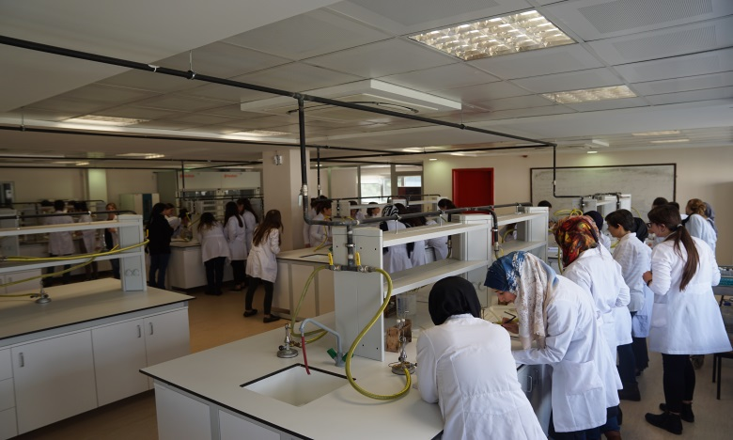
Research
Unit Operations Laboratory
Biotechnology Laboratory
Quality Control Laboratory
Sensory Analysis Laboratory
Research Laboratoriess
General Chemistry Laboratory
Analytical Chemistry Laboratory
Mmicrobiology Laboratoryy
Instrumental Analysis Laboratory
Food Chemistry Laboratory
Awared as Best Young Scientist
by
the Turkish Academy of Sciences

Slide 13
Accreditation

Slide 14
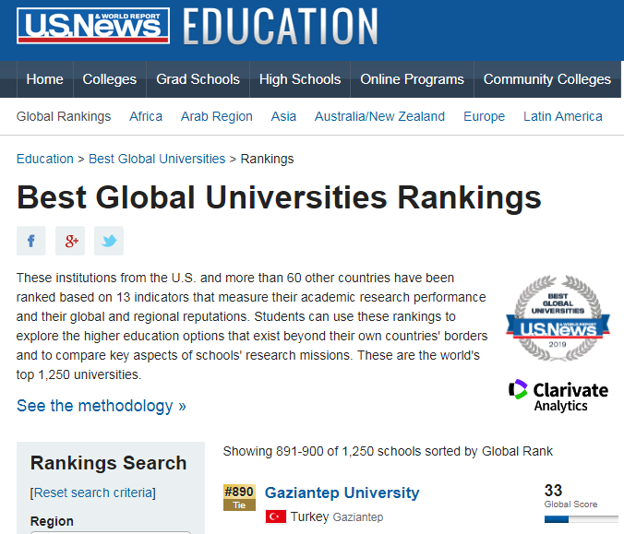
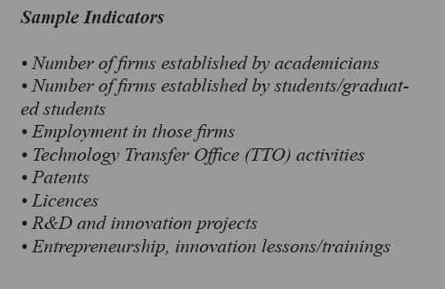
GAUN is landed on 890th at U.S. News “BEST GLOBAL UNIVERSITIES” rankings!
GAUN is ranked 15th at “Turkey Entrepreneurial and Innovative University Index”

Slide 15
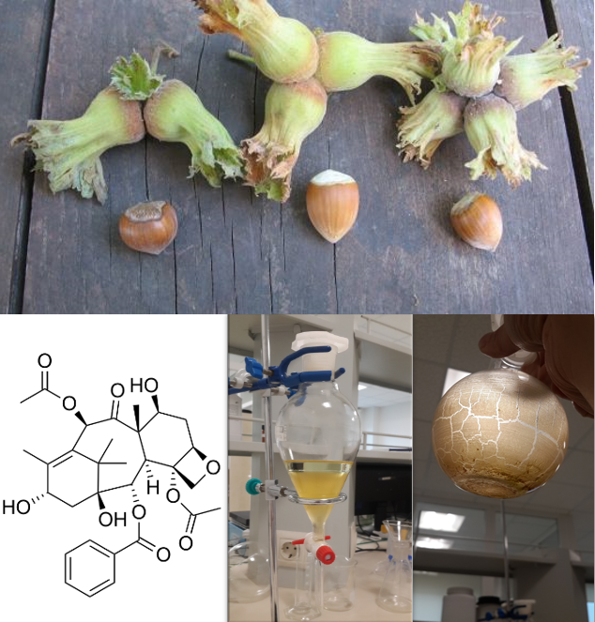
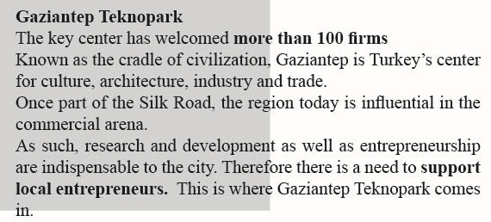
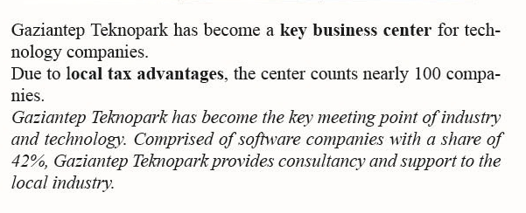
GAUN helps better understanding of the opportunities that may arise in the realization of the social and commercial activities of employees and individuals in daily life, working life and society.
Technology and Innovation

Slide 16
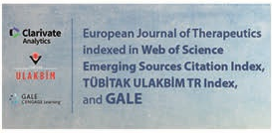
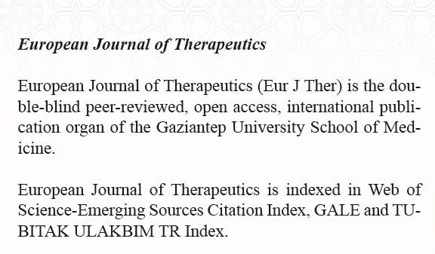
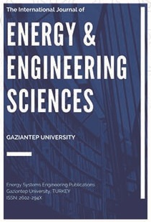
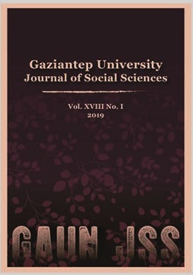
Peer reviewed Journals
"The International Journal of Energy & Engineering Sciences (IJEES) is an open access publisher of journals covering a wide range of academic disciplines. All papers are being published with an ISSN number by the publisher of Gaziantep University. IJEES is a peer-reviewed journal published tri-annual online by "Gaziantep University" in Turkey. This journal is designed for communication and discussion of scientific activities mainly in energy and engineering. The journal publishes only English articles. The manuscripts are checked by the editors. The manuscripts adopted to our journal style will then sent to our international reviewers.

Slide 17
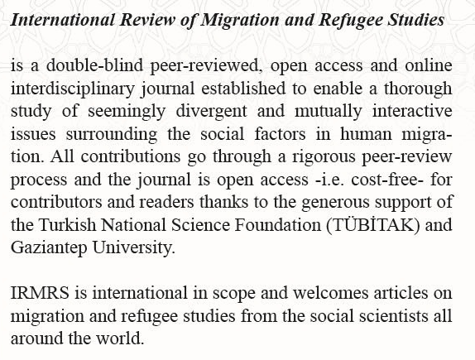
Gaziantep University Press

Slide 18
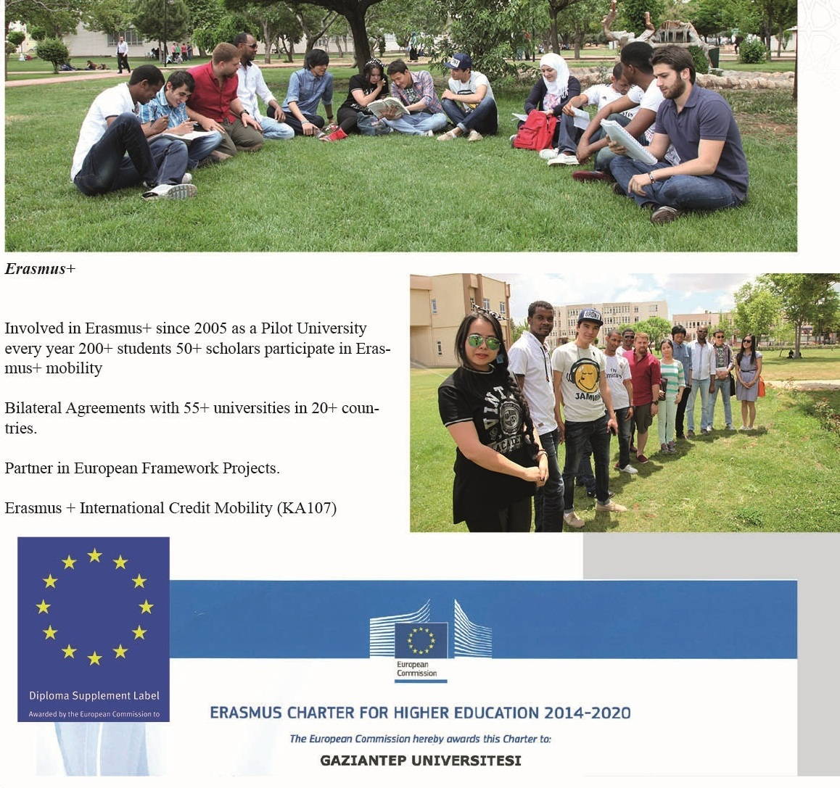
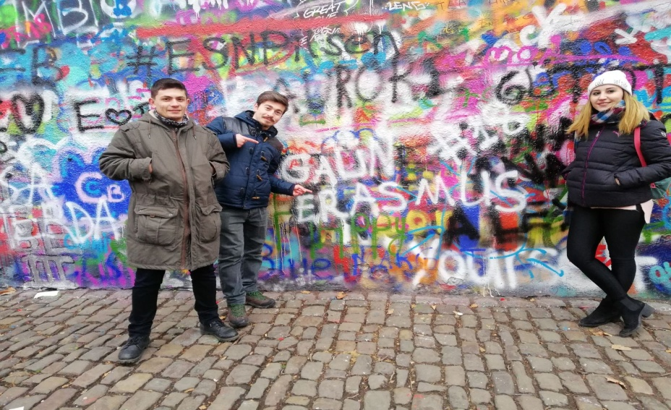
International Partnerships

Slide 19
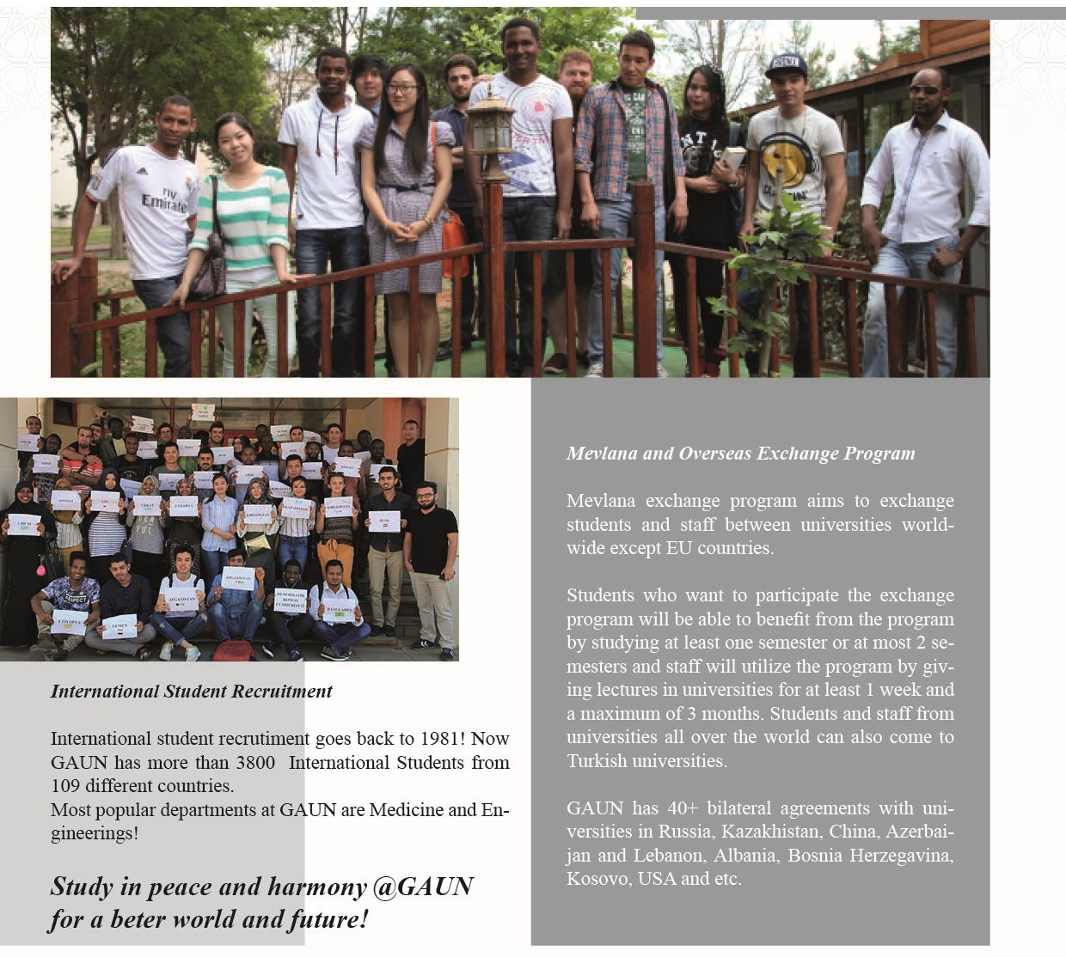
GAUN is landed on 36th with it’s international collaborations at “U.S. News BEST GLOBAL UNIVERSITIES” rankings!
Student Recruitment

Slide 20
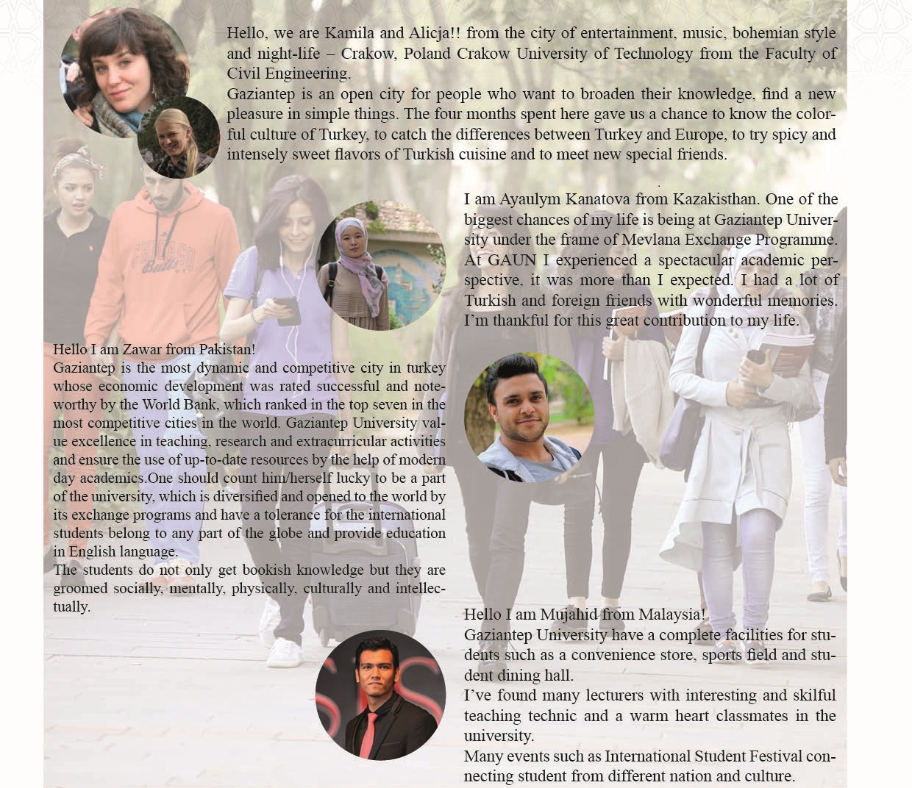
From GAUN

Slide 21
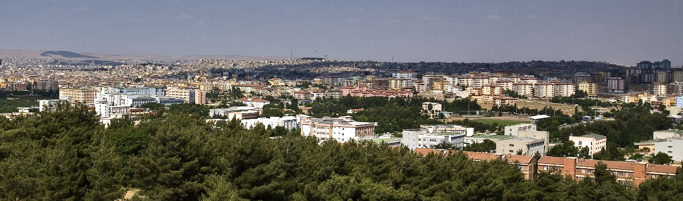
Thank you for your time incetahtaci@gantep.edu.tr

